Slide 1
Church Responses & Teachings on HIV & AIDS
Jo Ignacio
BEC & HIV/AIDS Program Coordinator
CBCP-NASSA

Slide 2
Catholic Bishops of the Philippines wrote in 1993
“In announcing the Good News of salvation, in healing the sick, in forgiving sinners, in being compassionate with the multitude, Jesus showed what the Church must do.
God’s people must be at the side of those who suffer. Especially for the needy and suffering today, the Church must be the Compassion of Jesus.”
Pastoral Letter on AIDS : In The Compassion of Jesus,
23 January 1993
Notes:
In a certain sense, we might say that the Catholic bishops of the Philippines prophetically anticipated this encyclical by the Holy Father when, in 1993, they wrote in their pastoral letter on AIDS:
In announcing the Good News of salvation, in healing the sick, in forgiving sinners, in being compassionate with the multitude, Jesus showed what the Church must do. God’s people must be at the side of those who suffer. Especially for the needy and suffering today, the Church must be the Compassion of Jesus.
Catholic Bishops’ Conference of the Philippines, The Compassion of Jesus, 23 January 1993.

Slide 3
The Church responds to the pandemic of HIV and AIDS as it does to every other human reality – from the depth of its mission:
As Servant
As Animator of spiritual life
& pastoral care
As Teacher

Slide 4
As Servant Church
Church-based health care is responsible for some 50% of all health service delivery in developing countries.
These extend to rural areas and have
been among the first in treating
patients living with HIV/AIDS.

Slide 5
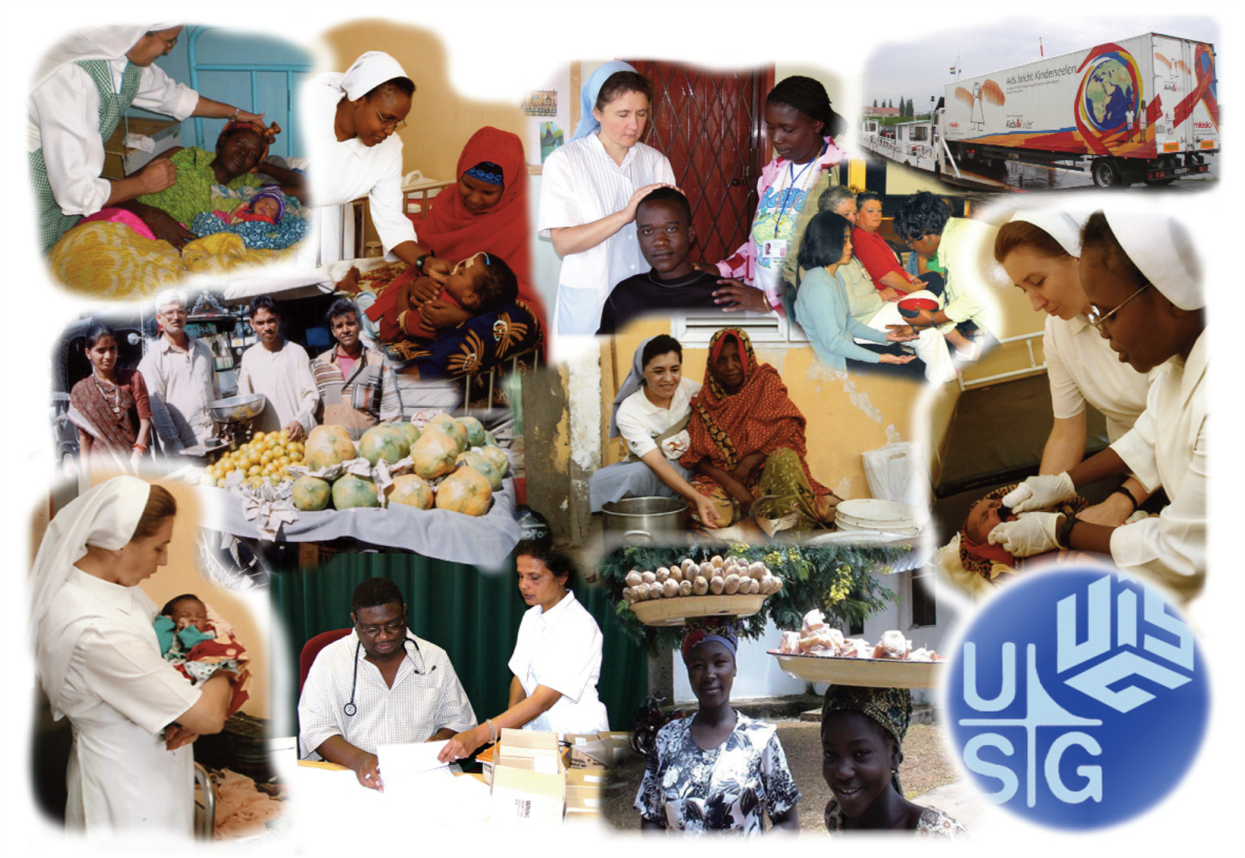

Slide 6
Programmes:
In-patient and out-patient health care
Home-based care (hospital- and community-based)
Voluntary Counseling and Testing
Psycho-Social Support
Chaplaincy Services
Prevention of Mother-to-Child Transmission
Orphan care
Income-Generating Activities
Blood safety

Slide 7
As animator of spiritual life & pastoral care

Slide 8
The Church is unique in its ability to offer pastoral care to those living – and dying – with or affected by HIV and AIDS
Church representatives need to speak openly about HIV and AIDS from the pulpit and in other settings.
Church leaders need to provide prayer, liturgies, anointing services, memorial services, rituals and symbols that are meaningful.

Slide 9
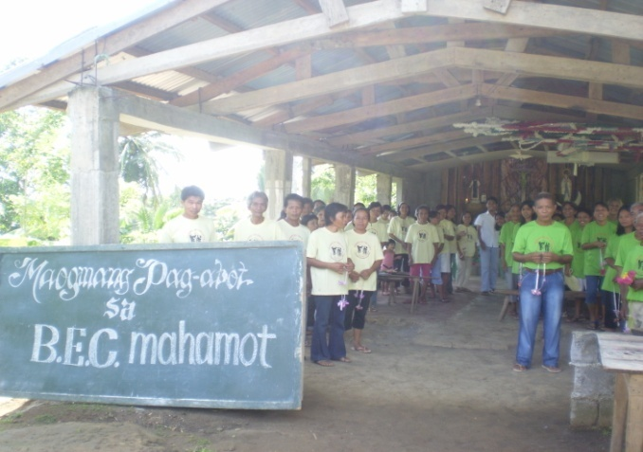
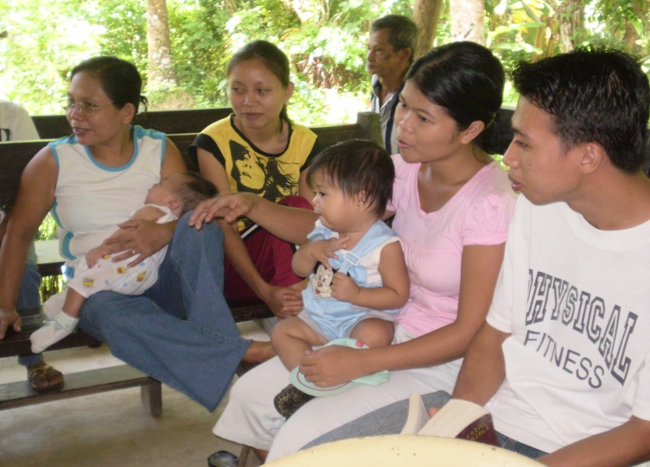
“Every local parish must establish itself as a privileged place where education about HIV & AIDS is disseminated and persons most vulnerable to the virus or living with or affected by the virus receive Jesus’ healing love through the physical, emotional and spiritual support of the members.”
- 2011 CBCP Pastoral letter on AIDS “Who is my neighbor?”

Slide 10
“Church workers, seminarians & the clergy, must be equipped with basic knowledge on HIV & AIDS and pastoral counseling skills …to bring hope, healing and reconciliation to those vulnerable to the virus, those infected and affected by HIV, through the sacraments and pastoral care.”
- 2011 CBCP Pastoral Letter on AIDS “Who is my neighbor?”

Slide 11

As Teacher
At the heart of episcopal teaching on HIV and AIDS is a call to return to the basic and solid values of the Gospel, with strong emphasis on compassion and service, and on responsibility and respect in sexual ethics: sexual activity within marriage only; sexual abstinence outside marriage.

Slide 12
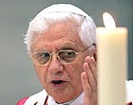
Pope Benedict XVI:
“Hearts must be converted”

Slide 13
“The God of Jesus Christ must be known, believed in and loved,
and hearts must be converted
if progress is to be made on social issues and reconciliation is to begin, and if – for example – AIDS is to be combated by realistically facing its deeper causes and the sick are to be given the loving care they need.
Notes:
Source: http://www.vatican.va/holy_father/benedict_xvi/homilies/2006/documents/hf_ben-xvi_hom_20060910_neue-messe-munich_en.html

Slide 14
Social issues and the Gospel are inseparable.
When we bring people only knowledge, ability, technical competence and tools, we bring them too little.” Pope Benedict XVI, Homily in Munich, 20 September 2006,

Slide 15
Church teaching: Both individual and social values
“In many cases, HIV/AIDS implies problems also at the level of existential values; it is true pathology of the spirit which harms not only the body, but the whole person, interpersonal relationships and social life, and is often accompanied by a crisis of moral values.”
Source: Cardinal Javier Lozano Barragán at UN Special Session on AIDS July 2001

Slide 16
“Parents & educators need to teach, by their word and example, the dignity of the human person, the beauty and sacredness of human love anchored on God’s love. Chastity and monogamous fidelity are the best protection from HIV & AIDS.”
- 2011 CBCP Pastoral letter on AIDS “Who is my neighbor?”

Slide 17
Education continues to be the only effective “vaccine” to combat denial, ignorance, and prejudice which places people at risk of contracting HIV.

Slide 18

Catholic Bishops in Africa reject the myth that AIDS is a punishment from God
Bishops of Southern Africa:
“AIDS must never be considered as a punishment from God. He wants us to be healthy and not to die from AIDS. It is for us
a sign of the times challenging all people to inner transformation and to the following of Christ in his ministry of healing, mercy and love.”
A Message of Hope to the People of God from the Catholic Bishops of South Africa, Botswana, and Swaziland. July 30, 2001.
Notes:
Church teaching has helped to reduce stigmatization and discrimination toward people living with HIV and AIDS. The “myth” that AIDS is God’s punishment on sinners has been strongly opposed by various Episcopal Conferences.

Slide 19
2011 CBCP Pastoral letter “who is my neighbor?”
“Pervasive stigma associated with HIV & AIDS is …a major barrier to an effective response...prevents people from talking about HIV and the behaviors that put them at risk for infection, and from seeking counsel and health services when such action could help protect themselves and their families from HIV infection.”
“Unfortunately, it exists in every corner of society,… even in our own faith communities.”

Slide 20
Catholic Church leaders exercise their teaching role re: HIV prevention
In unanimous fashion, church leaders have upheld the fundamental values and teaching of the Church – especially with regard to sexual activities and human relationships – i.e. sexual abstinence outside marriage and mutual, life-long faithfulness within marriage.
With regard to the extent of information to be included in HIV prevention education, however, some different approaches and views are evident.

Slide 21
CONSCIENCE – A MOST SECRET CORE AND SANCTUARy
“Deep within his conscience, man discovers a law which he has not laid upon himself but which he must obey. Its voice, ever calling him to love and to do what is right and to avoid evil, sounds in his heart at the right moment … His conscience is man’s most secret core and his sanctuary. There he is alone with God whose voice echoes in his depths.”
The Documents of Vatican II, “Pastoral Constitution on the Church in the Modern World (Gaudium et spes)”, par. 16 New York: Herder and Herder, 1966.

Slide 22
CONSCIENCE – A MOST SECRET CORE AND SANCTUARy
“We too preach the gospel, but we try above all to form consciences” [1]
Discernment of right or wrong in human acts, including those related to prevention of HIV:
must take place with the benefit of Church’s teaching on right values related to individual behaviour as well as to the common good
with support and counseling to hear the “voice of God” echoing in one’s conscience.
[1] Bishop Theodore Adrien Saar, President of Bishops’ Conference of Senegal at International Conference on AIDS in Religion, 1996.

Slide 23
Southern African Bishops discuss the situation of discordant couples …
“There are couples where one of the parties is living with HIV/AIDS … The Church accepts that everyone has the right to defend one’s life against mortal danger. This would include using the appropriate means and course of action.
Similarly where one spouse is infected with HIV/AIDS they must listen to their consciences. They are the only ones who can choose the appropriate means in order to defend themselves against the infection. Decisions of such an intimate nature should be made by both husband and wife as equal and loving partners.”
A Message of Hope from the Catholic Bishops to the People of God in South Africa, Botswana, and Swaziland, 30 July 2001.

Slide 24
Ethical Issues Related to HIV Prevention

Slide 25
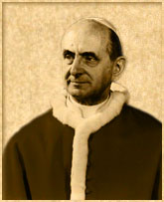
Is education about condom use for HIV prevention forbidden by Humanae Vitae?
“Each and every marital act must of necessity retain its intrinsic relationship to the procreation of life.” (Humanae Vitae, 11).
This document precedes our knowledge about HIV and thus could not have specifically addressed this issue.
Pope Paul VI considered as “intrinsically wrong” the use of condoms and other artificially contraceptive means for purposes of avoiding the transmission of new life.
Notes:
Now let us examine more deeply the Church’s teaching about prevention of the sexual transmission of HIV. First we must note that the issue of HIV prevention was not considered in Humanae Vitae since, when this encyclical was written in 1968, the world was not yet aware of the HIV pandemic. The encyclical deals with use of condoms – but only within the context of contraception.
Fr. Martin Rhonheimer, Professor of Ethics and Political Philosophy at the Pontifical University of the Holy Cross in Rome, writes on this topic as follows:
“The teaching of the Church is not about condoms or similar physical or chemical devices, but about marital love and the essentially marital meaning of human sexuality. It affirms that, if married people have a serious reason not to have children, they should modify their sexual behaviour by – at least periodic – abstinence from sexual acts. To avoid destroying both the unitive and the procreative meaning of sexual acts and therefore the fullness of mutual self-giving, they must not prevent the sexual act from being fertile while carrying on having sex.” [1]
He then proceeds to review some pastoral applications of the Church’s teaching to specific case situations:
“What do I, as a Catholic priest, tell Aids-infected promiscuous people or homosexuals who are using condoms? I will try to help them to live an upright and well-ordered sexual life. But I will not tell them not to use condoms. I simply will not talk to them about this and assume that if they choose to have sex they will at least keep a sense of responsibility. With such an attitude I fully respect the Catholic Church’s teaching on contraception.
This is not a plea for ‘exceptions’ to the norm prohibiting contraception. The norm about contraception applies without exception; the contraceptive choice is intrinsically evil. But it obviously applies only to contraceptive acts, as defined by Humanae Vitae, which embody a contraceptive choice. Not every act in which a device is used which from a purely physical point of view is “contraceptive”, is from a moral point of view a contraceptive act falling under the norm taught by Humanae Vitae.
Equally, a married man who is HIV-infected and uses the condom to protect his wife from infection is not acting to render procreation impossible, but to prevent infection. If conception is prevented, this will be an – unintentional – side-effect and will not therefore shape the moral meaning of the act as a contraceptive act. There may be other reasons to warn against the use of a condom in such a case, or to advise total continence, but these will not be because of the Church’s teaching on contraception but for pastoral or simply prudential reasons – the risk, for example, of the condom not working. Of course, this last argument does not apply to promiscuous people, because even if condoms do not always work, their use will help to reduce the evil consequences of morally evil behaviour.” [2]
[1] and [2] Source: Martin Rhonheimer, “The Truth about Condoms,” The Tablet, 07 October 2004.

Slide 26
A bishop and pastor about preventing sexual transmission of HIV
“The Church does not ‘advocate’ the use of condom as a means of struggling against AIDS; it advocates the fidelity of the couple and continence as the only means which are both efficacious and respectful of the dignity of the human person.
However, when someone decides to break the moral law concerning the exigencies of sexuality and love, the Church could not be opposed to that person taking the means to avoid catching or transmitting a mortal virus during their sexual relations.
But this person is not dispensed from questioning him or herself seriously about the morality of his or her behaviour and on the dehumanising character of his or her sexual life.”
- Bishop Maurice E. Piat, C.S.SP., Bishop of Port-Louis, Mauritius, 27 November 2000, in Speak Out on HIV & AIDS, Revised Edition, Nairobi, Kenya: Paulines Publications Africa, 2006, pp. 70-71.
Notes:
In November 2000, Bishop Maurice E. Piat, C.S.Sp., Bishop of Port-Louis, Mauritius, compellingly communicated the Church’s teaching about restricting sexual activity to marriage. He wrote:
“The Catholic Church makes her contribution to the struggle against AIDS and against maladies that are sexually transmitted with the means that are her own, by appealing to what is most noble in the human being: one’s conscience. Indeed, what allows a person to become truly responsible, is to learn how to reflect on his behaviour, to know how to control himself and to become free by being honest in relation to the moral values of life. By reflecting on his sexual behaviours and by confronting moral values, each one is called to become more human by being inspired by the meaning of love, fidelity and chastity. Chastity is precisely the virtue of the successful integration of sexuality in the life of a person. (Catechism of the Catholic Church, no. 2337)”
At the same time, he urged those who do not abide by Church teaching to take means to reduce the risk of sexual transmission of HIV.

Slide 27
Maintaining identity and integrity in HIV prevention education – It IS possible!
“The teaching of the Church is not about condoms or similar physical or chemical devices, but about marital love and the essentially marital meaning of human sexuality … Stopping the worldwide AIDS epidemic is not a question about the morality of using condoms, but about how to effectively prevent people from causing the disastrous consequences of their immoral sexual behaviour …
Campaigns to promote abstinence and fidelity are certainly and ultimately the only effective long-term remedy to combat AIDS. So there is no reason for the Church to consider the campaigns promoting condoms as helpful for the future of human society. But nor can the Church possibly teach that people engaged in immoral lifestyles should avoid them.”
Source: Martin Rhonheimer, “The Truth about Condoms”, in The Tablet, 07 October 2005.
Notes:
Conclusion
Is it possible for Catholic Church-related organisations to maintain their unique identity and integrity while facilitating HIV prevention education programmes? Through partnership with those who hold teaching authority in the Church and with those most vulnerable or already affected, most especially the young, such efforts are taking place on a daily basis and in every part of the world. Moreover, the results being achieved, in terms of significant behaviour change, will be longer-lasting and more effective than one-sided and incomplete condom promotion campaigns. Thus I will conclude with insights offered by Fr. Martin Rhonheimer, a priest of Opus Dei and professor of Ethics and Political Philosophy at the Pontifical University of the Holy Cross in Rome. He points out that the Catholic Church’s teaching on sexual relationships has been and always will be focused on marriage and the family. At the same time, he recognizes that those who do not conform to the teaching of the Church may have need of information to reduce the harm they could bring to themselves and/or others:
The teaching of the Church is not about condoms or similar physical or chemical devices, but about marital love and the essentially marital meaning of human sexuality … Stopping the worldwide Aids epidemic is not a question about the morality of using condoms, but about how to effectively prevent people from causing the disastrous consequences of their immoral sexual behaviour …
Campaigns to promote abstinence and fidelity are certainly and ultimately the only effective long-term remedy to combat Aids. So there is no reason for the Church to consider the campaigns promoting condoms as helpful for the future of human society. But nor can the Church possibly teach that people engaged in immoral lifestyles should avoid them.[1]
[1] Martin Rhonheimer, “The Truth about Condoms”, in The Tablet, 07 October 2005.

Slide 28
Pope Benedict XVI: Comments in Light of the World book
… the sheer fixation on the condom implies a banalization of sexuality, which, after all, is precisely the dangerous source of the attitude of no longer seeing sexuality as the expression of love, but only a sort of drug that people administer to themselves.
There may be a basis in the case of some individuals, as perhaps when a male prostitute uses a condom, where this can be a first step in the direction of moralization, a first assumption of responsibility, on the way toward recovering an awareness that not everything is allowed and that one cannot do whatever one wants.

Slide 29
Clarifications by Vatican Spokesman Fr. Federico Lombardi, SJ
The Pope reaffirms Church teaching, placing it in the perspective of the value and dignity of human sexuality as an expression of love and responsibility.
The Pope considers an exceptional circumstance in which the exercise of sexuality represents a real threat to another person’s life.
In such a case … the use of a condom … can be “a first act of responsibility’, rather than not using it and exposing the other person to a mortal risk.

Slide 30
The Philippine Church Response:
1993 Pastoral letter on AIDS “In the Compassion of Jesus”
Various Catholic organizations did independent initiatives on HIV/AIDS response
2006 UNAIDS developed “HIV/AIDS Training Manual
for Church workers”
2009 CBCP-NASSA got involved thru a project
“Building a Community of HIV/AIDS Educators within Basic Ecclesial Communities”
2010 First National Catholic Forum sponsored by CBCP- NASSA & the Philippine Catholic HIV & AIDS Network (PhilCHAN) was launched with 19 members

Slide 31
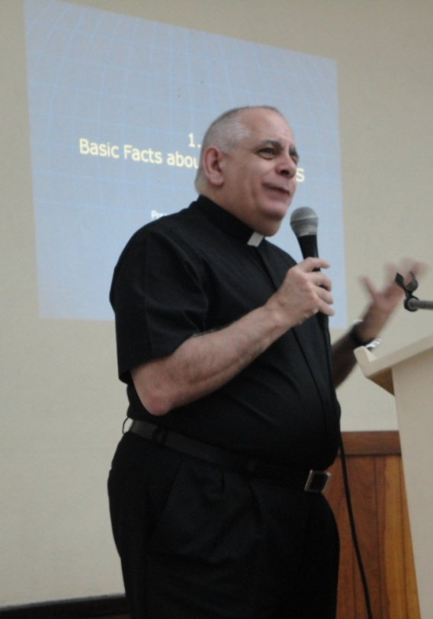
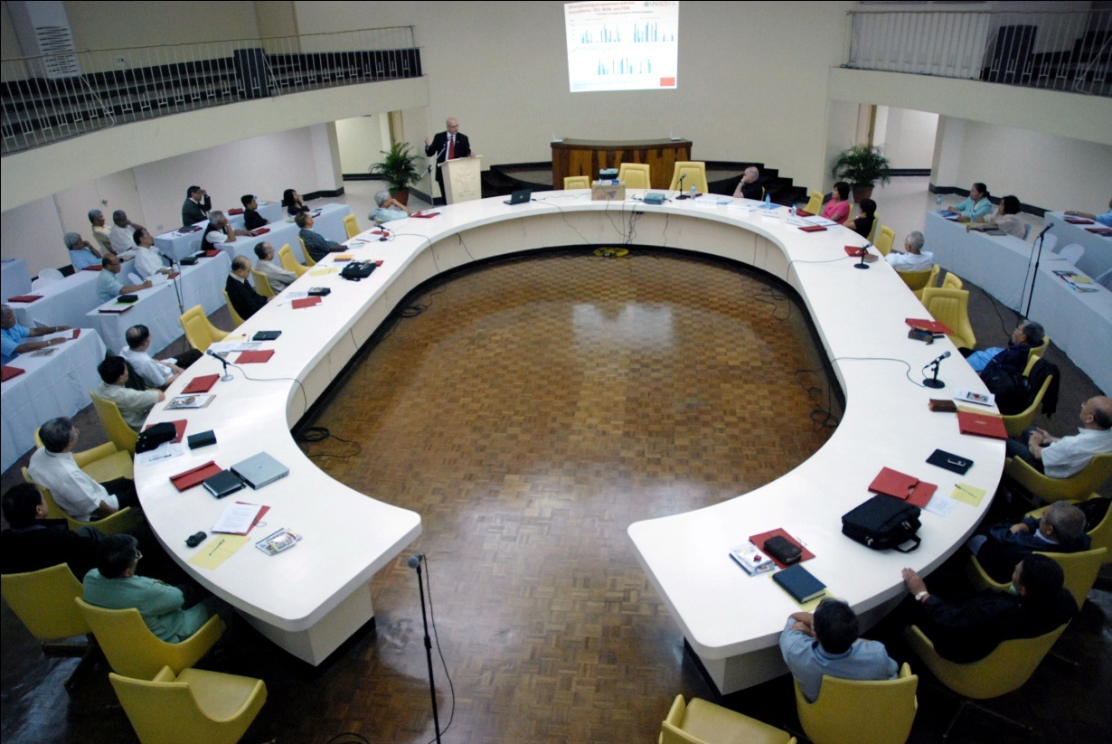
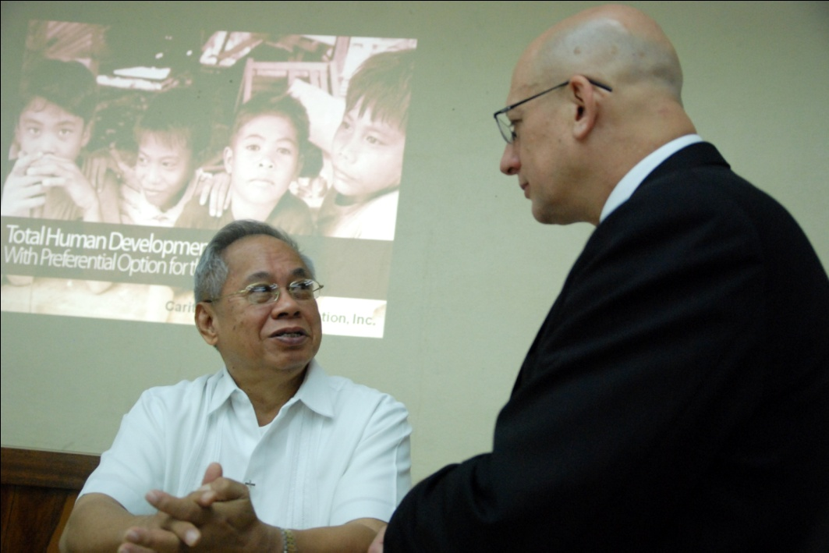
HIV SEMINAR OF CBCP January 27, 2011

Slide 32
January 2011 CBCP had a seminar on HIV/AIDS
Feb 2011 First General Assembly of PhilCHAN with 44 members
July 2011 CBCP released Pastoral letter on AIDS “Who is my neighbor?”
In the same Plenary assembly, CBCP declares first Sunday of December
as Catholic AIDS Sunday.

Slide 33
The Philippine Catholic HIV & AIDS Network
Bishop-Advisor is Bp Broderick S. Pabillo, DD
National Director of CBCP-NASSA/Caritas Filipinas Foundation Inc.
CBCP-NASSA as Secretariat of the Network
CEAP as member of PhilCHAN

Slide 34
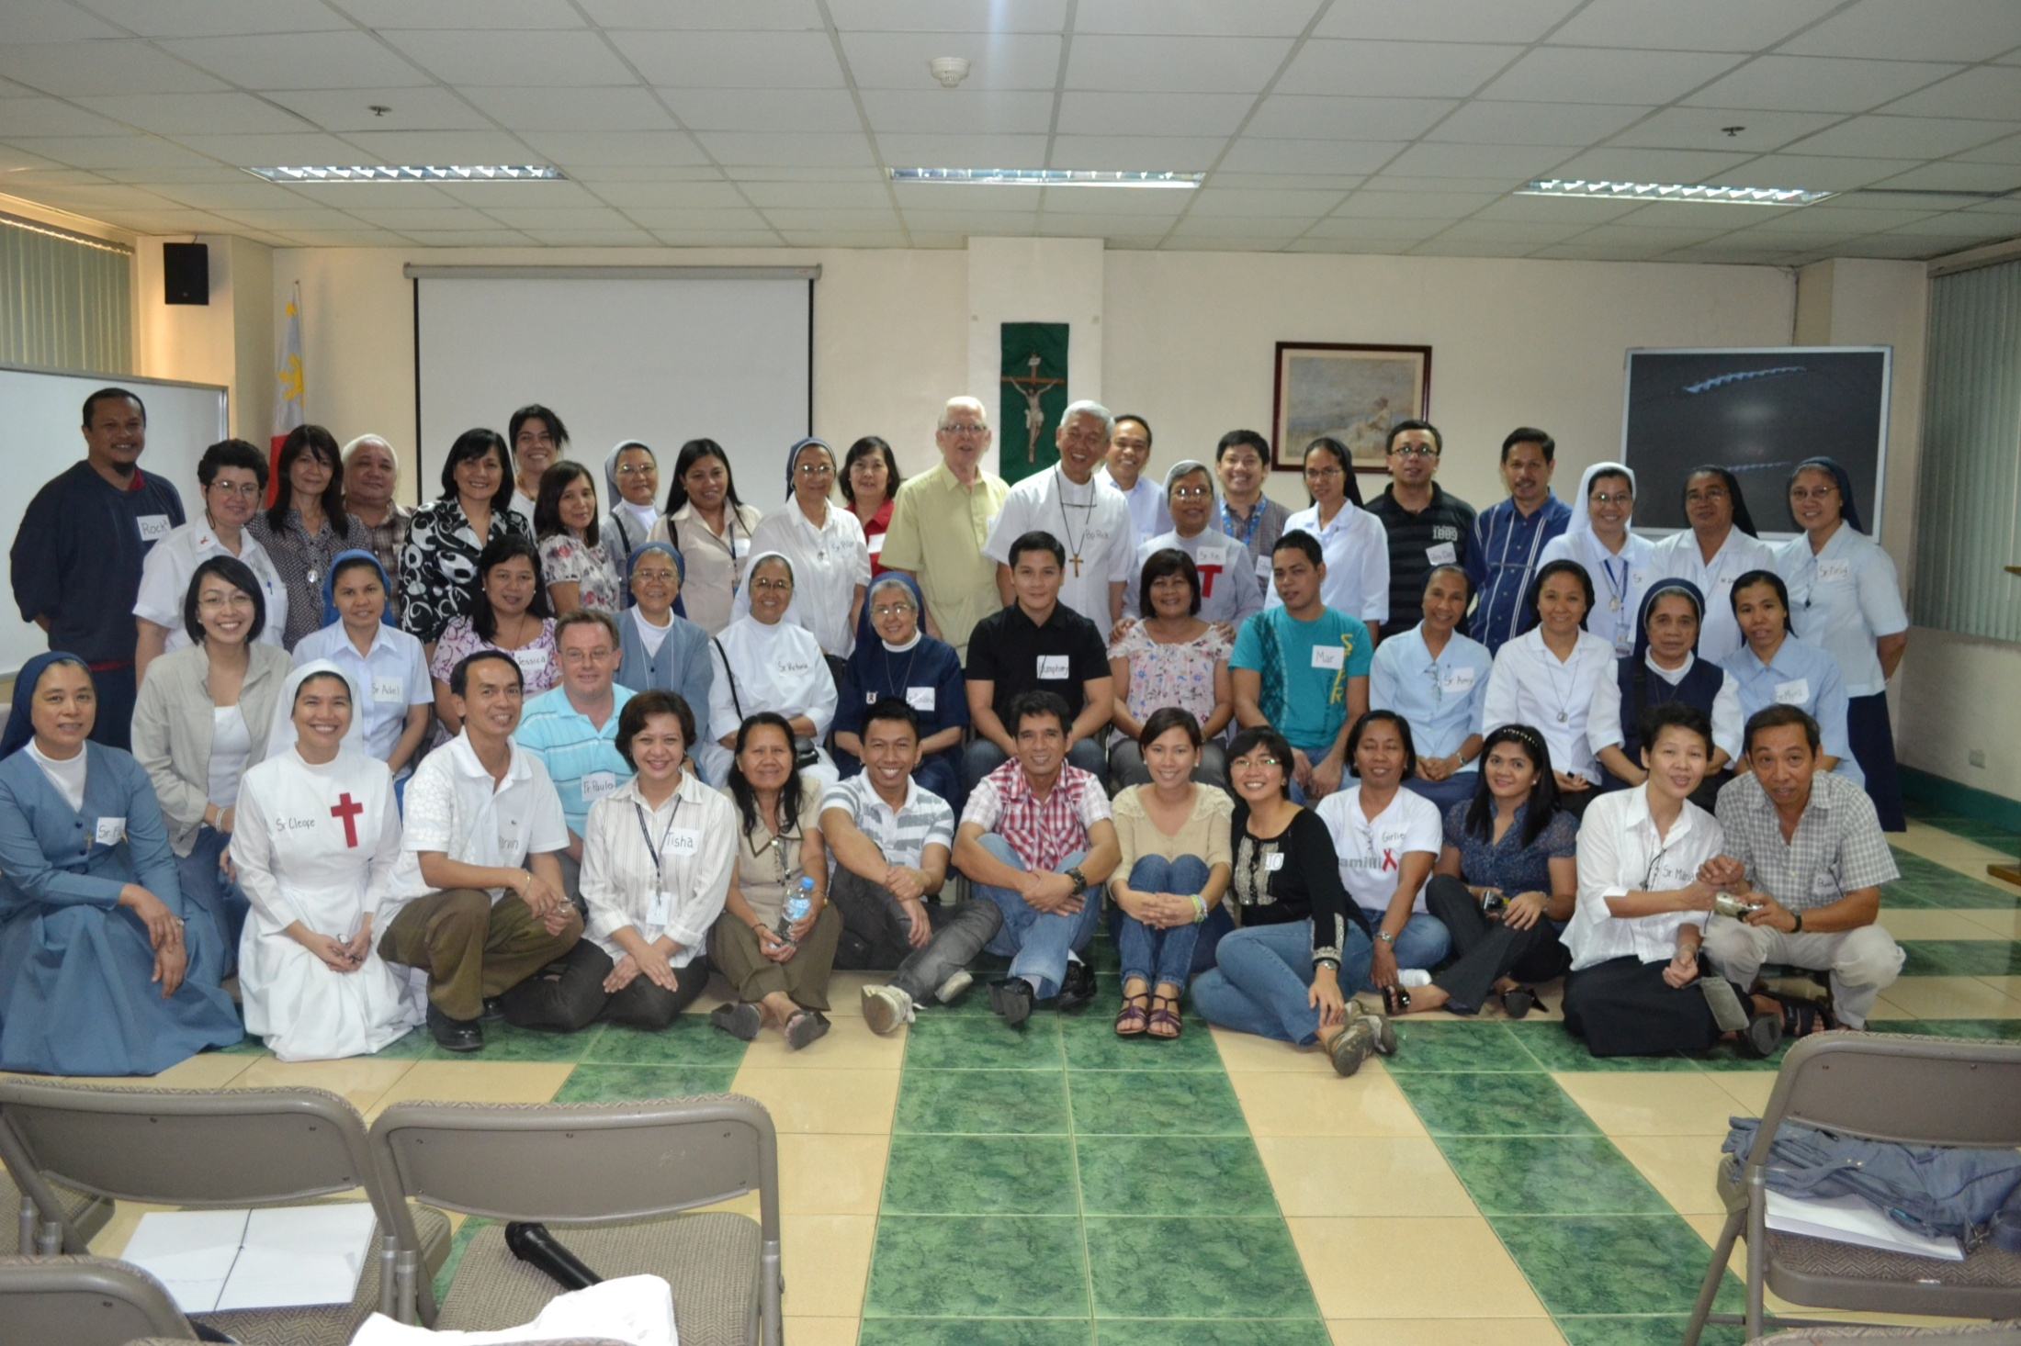
1st General Assembly of Philippine Catholic HIV & AIDS
Network with 44 member-organizations (February 10, 2011)

Slide 35
Vision
PhilCHAN
is a dynamic bastion of healing & hope
committed to bringing the everlasting love of God to people living with and affected by HIV & AIDS and
to helping create an HIV-free society.

Slide 36
mission
Coordinates care, formation and accompaniment of people living with HIV & AIDS, and health/medical personnel and pastoral/spiritual workers;
Facilitates training and development programs on the prevention, monitoring and management of the disease;
Networks with other supporters for continuous growth and sustainability;

Slide 37
Strengthens capabilities and motivation of
the members of the Network;
Lead by giving voice to the human rights of
PLHIV, eliminating stigma & discrimination
and empowering them to live with dignity;
and,
Create an environment of open, responsive,
and comprehensive exchange of
communication and information on the fight
against HIV & AIDS

Slide 38

Appeal of Pope Benedict XVI on occasion of World AIDS Day 2007
“I wish to exhort all people of good will to increase their efforts to halt the spread of the HIV virus, to combat the disdain which is often directed towards people who are affected by it, and to care for the sick, especially those who are still children.”
“INCREASE EFFORTS TO HALT THE SPREAD OF AIDS VATICAN CITY, NOV 28, 2007 (Vatican Information Service)
Notes:
Pope Benedict XVI has chosen to walk in the footsteps of his predecessor by encouraging the Church to become strongly engaged in the response to the global pandemic of HIV.

Slide 39
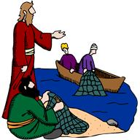
Are you ready to follow me?

Slide 40
A Moment with God: individual reflection
As an educator,
How do I grow more to be like Jesus in His compassion and love?
What are the ideas, the things I need to give up?
Am I ready to help people with HIV/AIDS no matter how they got the virus...because they are my neighbor?

Slide 41
Group activity / per school
Compose a prayer to be read in the Prayer of the Faithful during the Eucharistic celebration on the last day.

